Slide 1




Team Details
Team Name: GANAPATI
Team Leader name: GOURAV SINGH
Problem statement: TRACK 1 :- GENERAL
“WE CODE TO CREATE”

Slide 2


Problem :- The $280 Trillion Statement
ILLIQUIDITY:
Capital is trapped for 5-10 years. Exiting a position takes months of manual paperwork.
2) Border Friction
High yield emerging markets are legally inaccessible to most foreign investors.
3) Blind trust
Traditional syndicate relies on opaque, manual escrow with high counter party risk

Slide 3

Solution:-
CRESTADEL – “ OWN THE WORLD , BUILD YOUR PORTFOLIO ”
INSTANT DIGITAL EQUITY :- WE TRANSFORM PROPERTY INTO FRACTIONAL DIGITAL TOKENS , GUARANTEEING 24/7 LIQUIDITY ON A GLOBAL DECENTRALISED EXCHANGE (DEX)
AUTOMATED RISK ESCROW :- SMART CONTRACT ESCROW LOCKS AND DEPLOYS CAPITAL ONLY WHEN VALIDATED PROJECT MILESTONES ARE MET , ENSURING MAXIMUM SECURITY AND DEVELOPER ACCOUNTABILITY
SOVEREIGN COMMAND :- INVESTORS GAIN ABSOLUTE GLOBAL CONTROL AND GOVERNANCE OVER THEIR TIER 1 ASSETS FROM A SINGLE MOBILE DAPP

Slide 4
Technologies used and their use cases :-
LAYER | TECHNOLOGY
BLOCKCHAIN | CARDANO(PREPOD)
SMART CONTRACTS | AIKEN
OFF-CHAIN | TYPESCRIPT+MESHJS
FRONTEND | FLUTTER (DART)
JS BRIDGE | LUCID CARDANO
API | BLOCKFROST
ORACLE | ORCFAX
HOSTING | CLOUDFARE PAGES
L2(OPTIONAL) | HYDRA(OFFLINE IMPLEMENTATION)

Slide 5

Features of the solution
1. FRACTIONAL DIGITAL EQUITY
2. INSTANT GLOBAL LIQUIDITY
3. FRACTIONAL DIGITAL EQUITY
4. SOVEREIGN MOBILE COMMAND
5. AUTOMATED GOVERNANCE

Slide 6
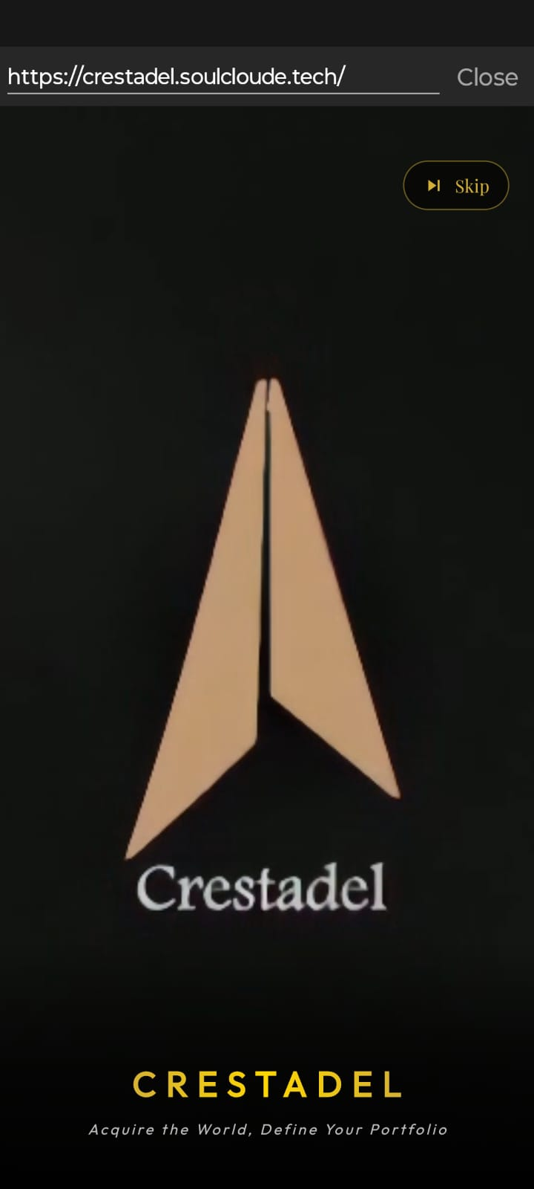
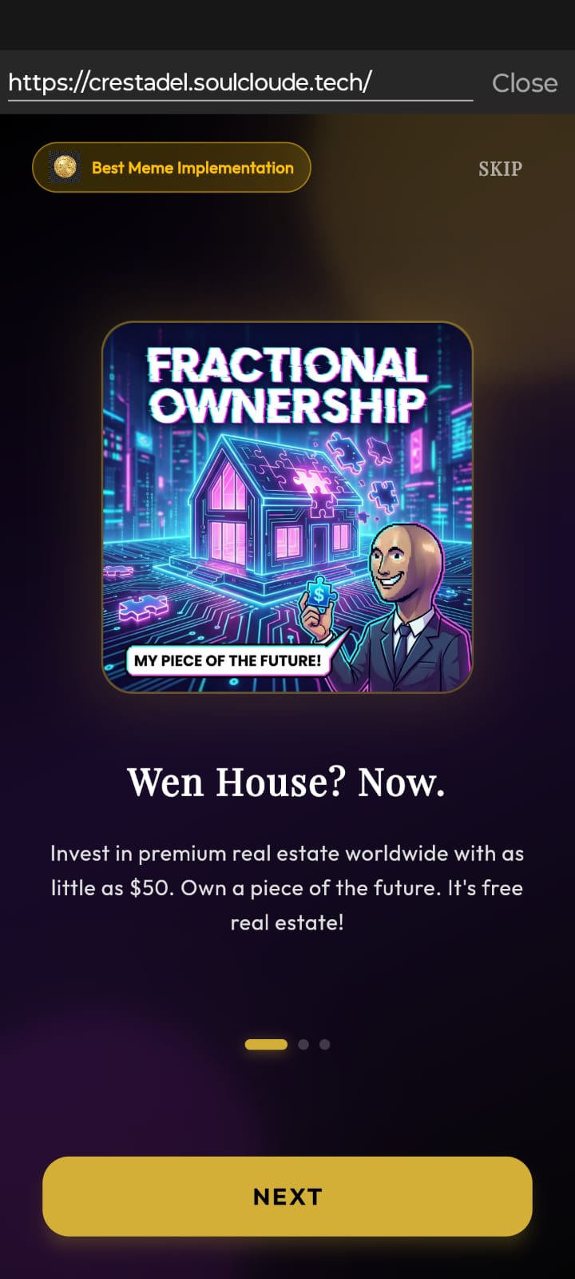
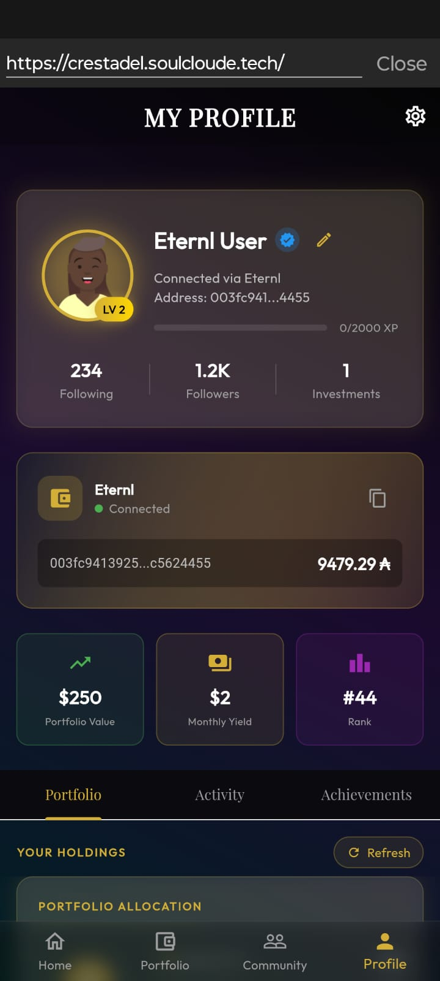
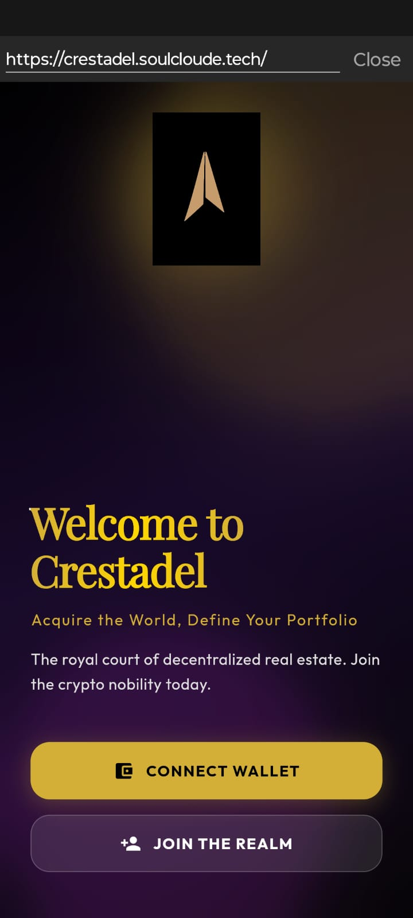
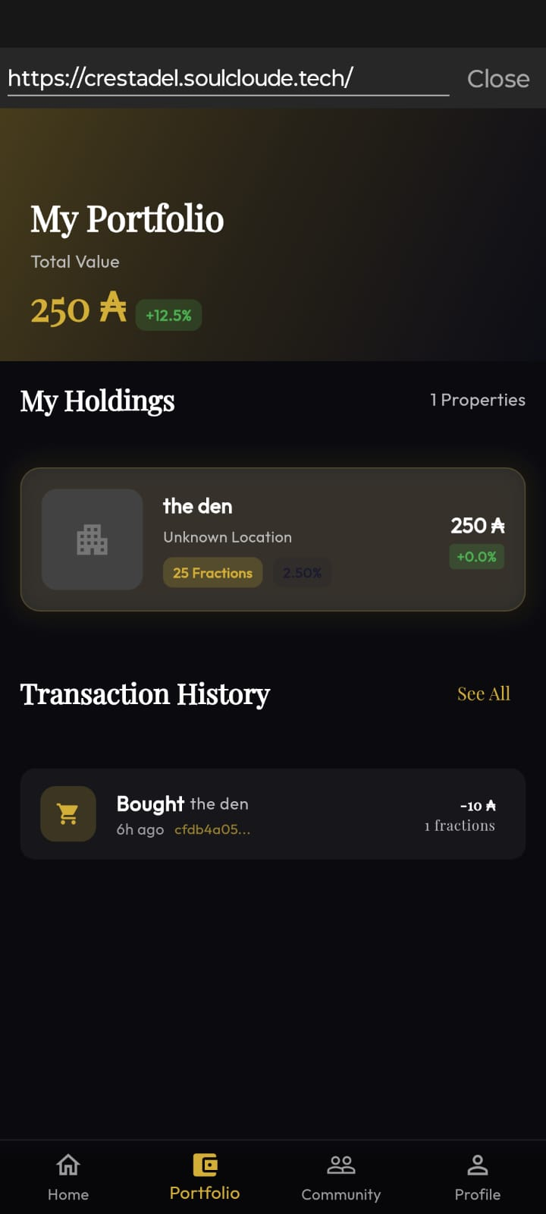
Experience Sovereign Control
Seamlessly Integrated with ETERNL & LACE

Slide 7
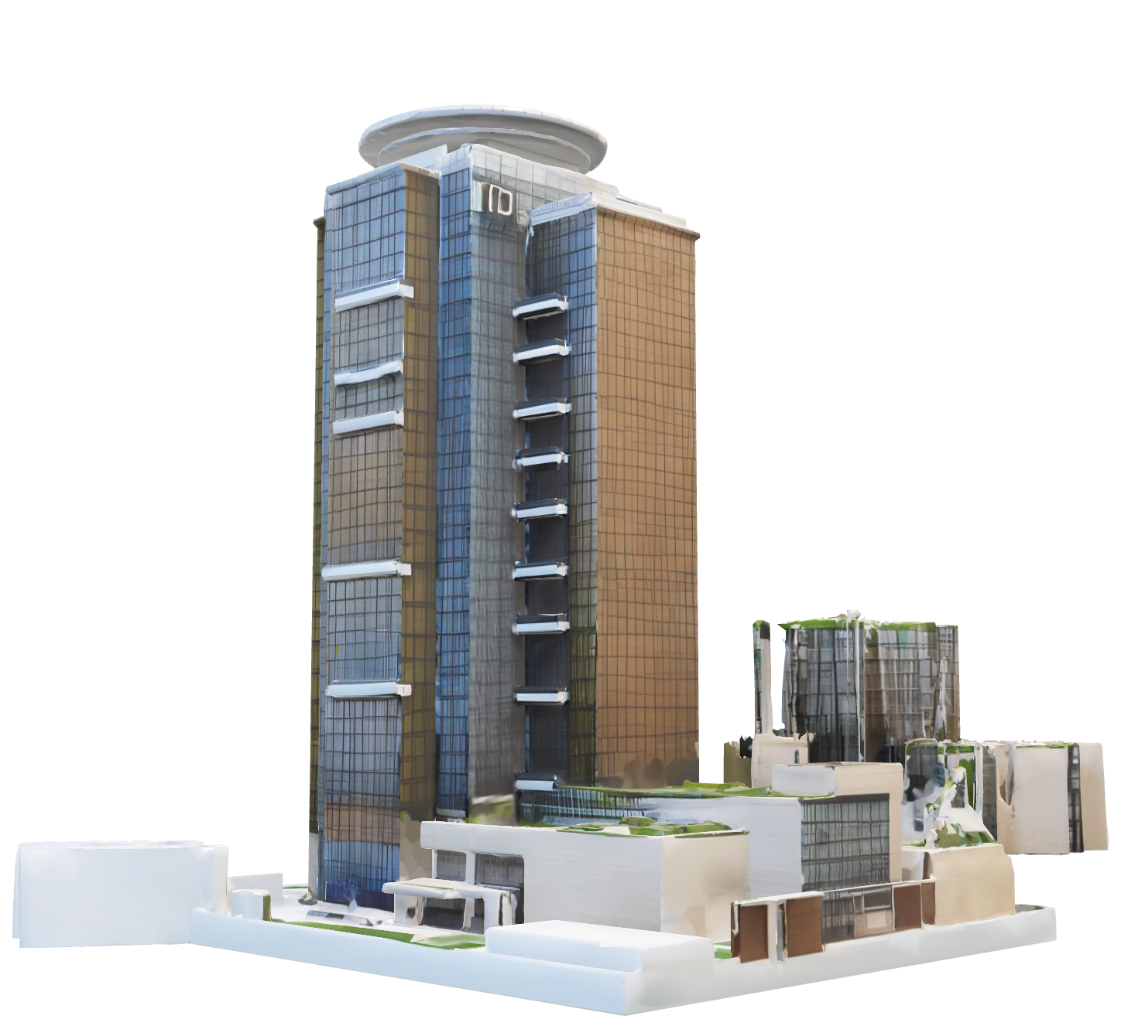
Impact of the solution
1. FRACTIONAL DIGITAL EQUITY
2. INSTANT GLOBAL LIQUIDITY
3. SMART SYNDICATION ESCROW
4. SOVEREIGN MOBILE COMMAND
5. AUTOMATED GOVERNANCE (DAO)

Slide 8
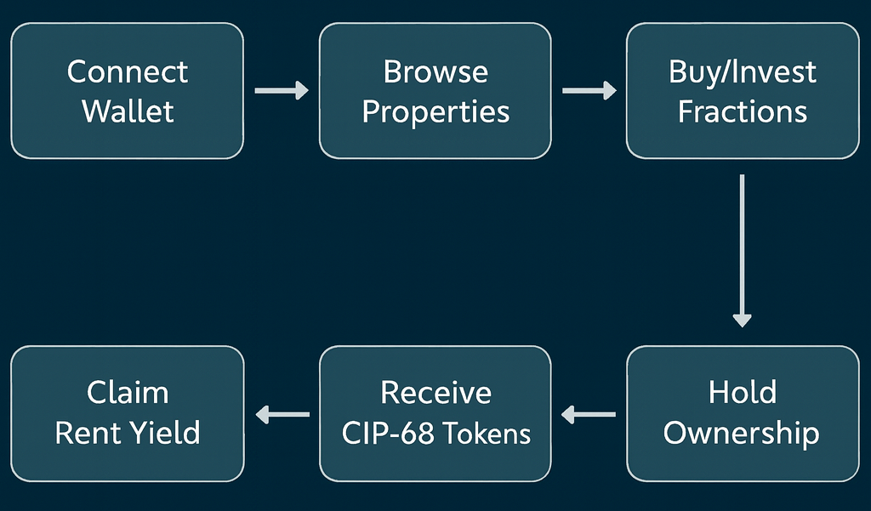
Architecture diagram of the proposed solution

Slide 9


How is this solution different from others
FEATURES | CRESTADAL | REALT | LOFTY
CARDANO SUPPORT
LIQUIDITY AND EXIT
INVESTOR CONTROL
ASSET FOCUS
ACTIVE CO-SYNDICATION
GLOBALLY RESILIENT

Slide 10

Future scope & CTA
ESG-Native Tokenization
AI Yield Forecasting
Immersive Asset Visualization
B2B Protocol API
Founding Syndicate
Pilot Partnership
Architect the Future

Slide 11


